Slide 1
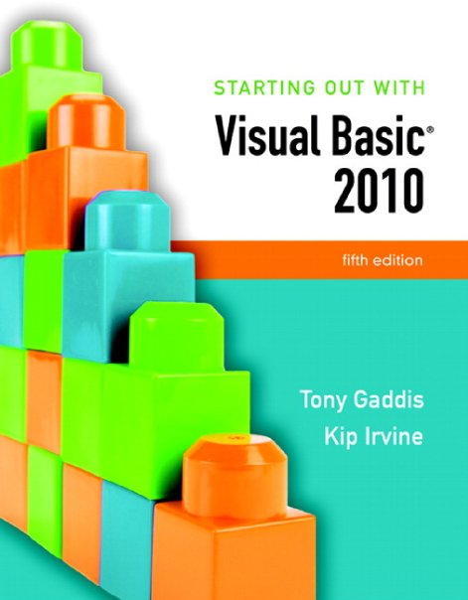

Slide 2
Chapter 2
Creating Applications with Visual Basic

Slide 3
Focus on problem Solving: Building the Directions Application
Section 2.1
In this section you create your first Visual Basic application:
a window that displays a map and road directions to a hotel. In the
process you learn how to place controls on a form and manipulate
various properties.

Slide 4
Define What the Application is To Do
Purpose: Display a map to the Highlander Hotel
Input: None
Process: Display a form
Output: Display on the form a graphic image showing a map

Slide 5
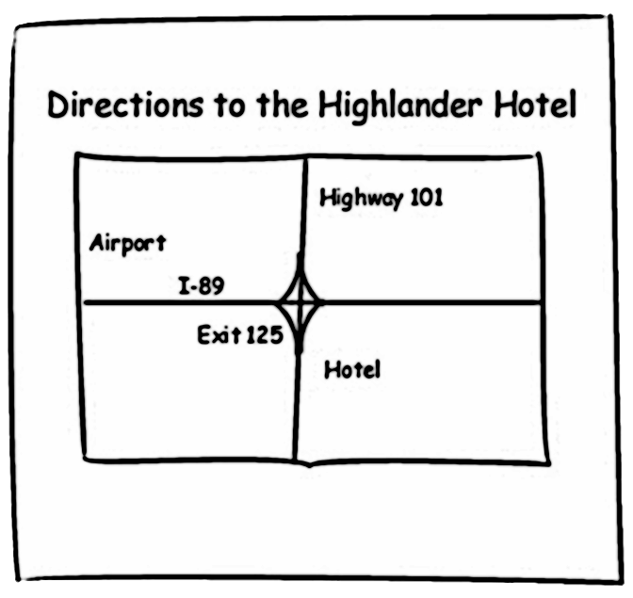
Visualize the Application and Design Its User Interface
Below is a sketch of the application’s form

Slide 6
Determine the Controls Needed
Control Type Control Name Description
Form Form1 A small form that will serve as (Default Name) the window onto which the other controls will be placed Label Label1 Displays the message (Default Name) "Directions to the Highlander Hotel" PictureBox PictureBox1 Displays the graphic image (Default Name) showing the map to the hotel

Slide 7
Define Relevant Property Values for Each Control
Form
Name: Form1
Text: "Directions"
Label
Name: Label1
Text: "Directions to the Highlander Hotel"
TextAlign: MiddleCenter
Font: Microsoft sans serif, bold, 18 point
PictureBox
Name: PictureBox1
Picture: HotelMap.jpg
SizeMode: StretchImage

Slide 8
Create the Forms and Other Controls Using Visual Basic
Establish the Form and set its Text property
Add a Label control
Position and resize it on the form
Set Text, TextAlign, and Font properties
Add a PictureBox control
Position and resize it on the form
Set Image property to display HotelMap.jpg
Run the application
Close and save the application

Slide 9
Design Mode, Run Mode, and Break Mode
Visual Basic has three modes in which it operates:
Design Mode
the mode in which you create the application
also known as design time
Run Mode
executes the application in the Visual Studio environment
also known as run time
Break Mode
momentarily suspends execution of a running application
for testing and debugging purposes

Slide 10
Project Organization On Disk
User creates a new project in Visual Studio
A solution and a folder are created at the same time with the same name as the project
The project belongs to the solution
Multiple projects can be included in a solution
The folder stores files related to the project including:
A solution file (.sln)
A project file (.vbproj)

Slide 11
Opening an Existing Project
Use Recent Projects list on Start Page
Provided it hasn’t been moved or deleted
Use Open Project button on Start Page
Then browse using Open Project dialog box
Use Open Project option on File menu
Then browse using Open Project dialog box

Slide 12
Properties Window
Used to view and modify the property values of a given object
Two views of the properties are available:
Alphabetic (across all properties)
Categorized (groups properties by logical use)

Slide 13
Focus on problem Solving: Responding to Events
Section 2.2
An application responds to events, such as mouse clicks and
keyboard input, by executing code known as event handlers.
In this section, you write event handlers for the Directions
application.

Slide 14
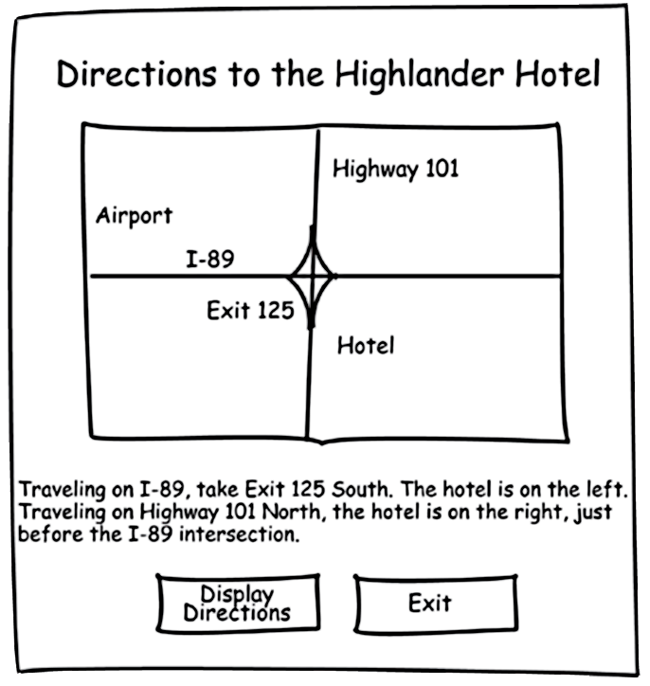
Modify the Directions Application
The Highlander Hotel manager would like you to add the following items to the application:
A Label containing the written directions
A Button to display the directions
A Button to exit the application

Slide 15
Controls to be Added
Control Type Control Name Description Label lblDirections Displays written directions to the hotel Button btnDisplayDirections When clicked, causes lblDisplayDirections text to appear on the form Button btnExit Stops the application when clicked

Slide 16
Control Properties
Label
Name: lblDirections
Text: “Traveling on I-89,…etc”
Visible: False
Button
Name: btnDisplayDirections
Text: “Display Directions”
Button
Name: btnExit
Text: “Exit”

Slide 17
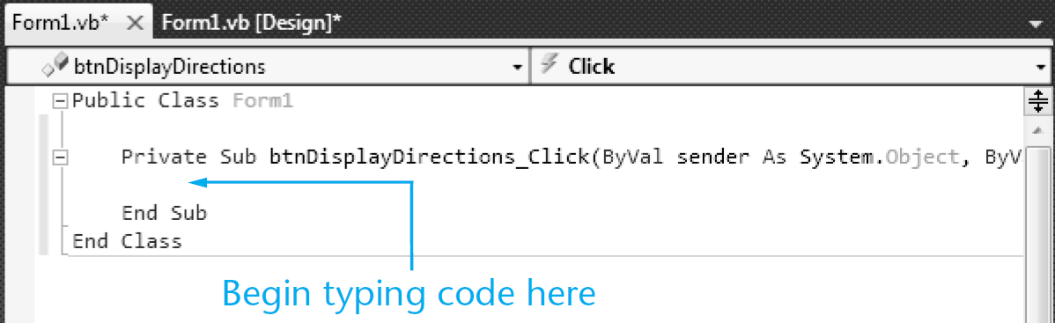
The Code Window
Double-clicking a control in design mode:
opens the code window
creates a code template for the control’s event handler where you fill in the code for the event

Slide 18
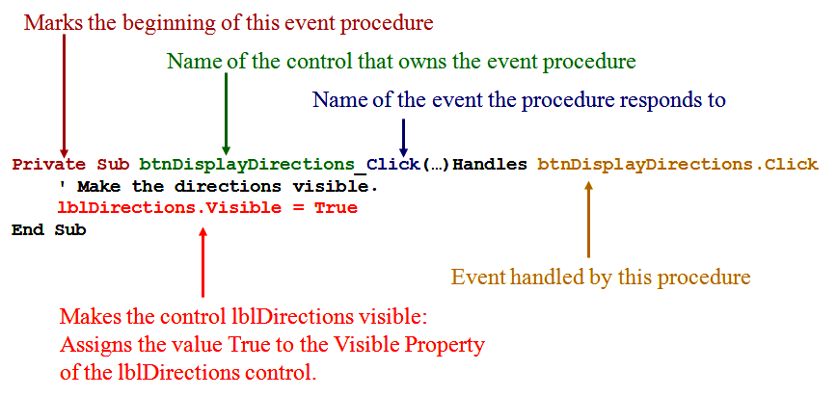
The Click Event Handler for btnDisplayDirections

Slide 19
Changing a Control’s Visible Property in Code
Specify the control name (lblDirections)
Then a dot
Then the PropertyName (Visible)
For example:
lblDirections.Visible
refers to the Visible property of the lblDirections control
The visible property values may only be true or false

Slide 20
The Assignment Statement
Specify the item to receive the value
Then the equal symbol
Then the value to be assigned
For example:
lblDirections.Visible = True
Assigns the value True to the Visible property of the lblDirections control
Causes the text of the lblDirections control to become visible to the user

Slide 21

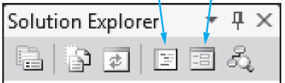

Switching Between the Code Window and the Designer Window
Window Tabs
Solution Explorer Icons
Menu Bar
Keyboard Shortcuts
F7 opens the Code Window
Shift + F7 opens the Designer Window

Slide 22
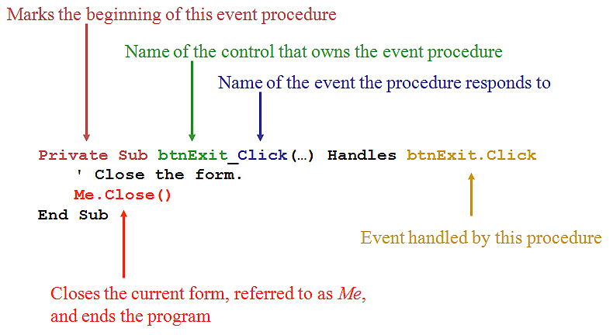
The Click Event Handler for btnExit

Slide 23
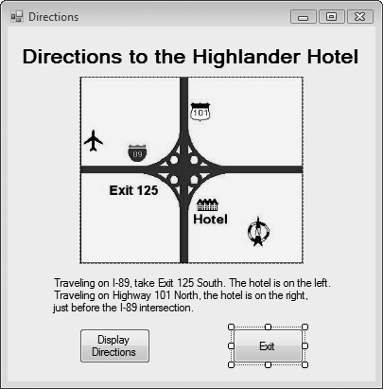
Use Visual Basic to Update the Application
Place the label and the buttons on the form
Enter the code for the two procedures
Test the application

Slide 24
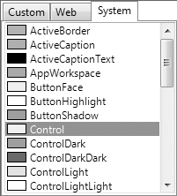
Changing Text Colors
Color properties for a control:
BackColor: Sets the background (fill) color
ForeColor: Sets the foreground (text) color
In the properties window:
click on the down arrow
select a color from the list

Slide 25
Setting the FormBorderStyle Property
Border style properties for a form:
Sizable: (Default) Has min, max, and close buttons; can be resized by dragging edges
Fixed3D: Has a 3D look; min, max, and close buttons; cannot be resized
FixedSingle: Has single line border; min, max, and close buttons; cannot be resized

Slide 26


Locking the Controls
Locking controls prevents them from being moved around during design time
To Lock Controls:
right-click an empty space on the form
select Lock Controls from the menu
To Unlock Controls:
right-click an empty space on the form
select Lock Controls from the menu
Control Locking has a Toggle Effect:
Follow the same steps to lock/unlock controls

Slide 27
Printing Your Code
To print a project’s code:
open the Code window
click File on the menu bar
click on the Print command
Using the keyboard shortcut:
open the Code Window
Ctrl + P to print

Slide 28
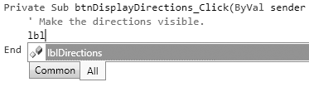
Using IntelliSense
IntelliSense is a feature that provides automatic code completion as you type programming statements
Press the Tab key to use IntelliSense
For Example:

Slide 29
Modifying A Control’s Text Property With Code
Section 2.3
Quite often, you will need to change a control’s Text property with
code. This is done with an assignment statement.

Slide 30
Modifying the Text Property in Code
Suppose a form is established with a label lblMessage whose Text property is:
1 Kilometer = ?
And on a btnFeet button click, we want to change the value of the text property to:
1 Kilometer = 3,281 feet

Slide 31
Modifying the Text Property in Code
Private Sub btnFeet_Click(…) Handles btnFeet.Click
' Display the conversion to feet.
lblMessage.Text = "1 Kilometer = 3,281 feet"
End Sub
Assigns the string to the right of the equal sign to the text property of lblMessage
This replaces the previous text property of lblMessage with the new value shown

Slide 32
The AutoSize, BorderStyle, and TextAlign Properties
Section 2.4
The Label control’s AutoSize property determines whether a label
will change size automatically to accommodate the amount of text
in its Text property, or remain a fixed size. The BorderStyle property
allows you to set a border around a Label control. The TextAlign
property determines how the text is aligned within the label.

Slide 33
The AutoSize Property
AutoSize is a Boolean (either True or False) Property of labels
False (the default) means the box size will not change, regardless of the amount of text assigned to it
True means the box will automatically resize itself to fit the amount of text assigned to it

Slide 34

The BorderStyle Property
BorderStyle determines the look of the box
None (the default) means no border
FixedSingle results in a border one pixel wide
Fixed3D gives the border a recessed 3-dimensional look

Slide 35
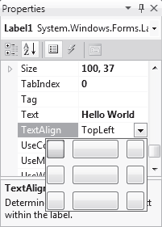
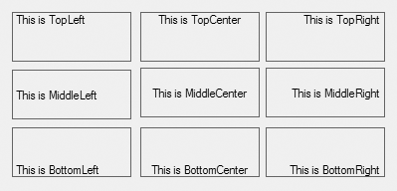
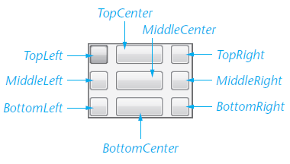
The TextAlign Property
The value of TextAlign establishes the alignment (or justification) of the text:

Slide 36
The TextAlign Property
You can change a label’s TextAlign property with code at runtime
For example:
Assume an application uses a Label control named lblReportTitle
The following statement aligns the control’s text with the middle and center of the control’s bounding box
lblReportTitle.TextAlign = ContentAlignment.MiddleCenter

Slide 37
Displaying Message Boxes
Section 2.5
You can use the MessageBox.Show method to display a message
box, which is a dialog box that pops up, showing a message to
the user.

Slide 38
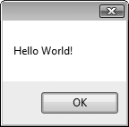
The Message Box
A message box is
a small window
sometimes referred to as a dialog box
a convenient way to display output to the user
displayed until the OK button is clicked
For example:
MessageBox.Show("Hello World!")
MessageBox
dot
Show
string “Message” enclosed in parentheses

Slide 39
Clickable Images
Section 2.6
Controls other than buttons can have Click event handlers. In this
section, you learn to create PictureBox controls that respond to
mouse clicks.

Slide 40
PictureBox Control
As we saw earlier the Image Property can be set to a graphic image of some sort
The flag images in Tutorial 2-16 are clickable
The click event can be handled by code to take whatever action is desired

Slide 41
PictureBox Click Event code
When PictureBox picUSA is clicked, the lblMessage text property is set to display United States of America
Private Sub picUSA_Click(…) Handles picUSA.Click
' Display United States of America.
lblMessage.Text = "United States of America"
End Sub

Slide 42
Using Visual Studio Help
Section 2.7
Learn to use the Visual Studio Help System

Slide 43
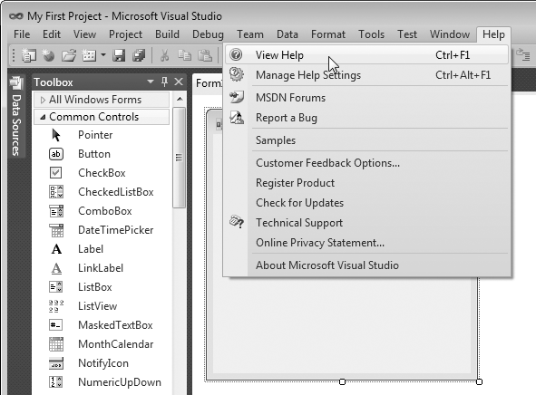
Accessing the Help System
You access the Visual Studio Documentation and the MSDN library by clicking Help on the menu bar.

Slide 44
Context-Sensitive Help (F1 Key)
Displays information about whatever feature the user is currently focused on
For example:
Click on a Button control
Press F1
Help explains all about the Button control
Click on a Label control
Press F1
Help explains all about the Label control

Slide 45
Debugging Your Application
Section 2.8
At some point, most applications contain bugs (errors) that prevent
the application from operating properly. In this section, you learn
fundamental debugging techniques.

Slide 46
Compile Errors
These are errors in the syntax (form) of your program
Visual Basic will inform you of these errors as soon as the code is entered
The area of the error will be underlined with a jagged blue line
A description of the error will be given in the Error List window
Display this window by selecting Error List from the View menu option

Slide 47
Runtime Errors
Some errors occur as your program runs
These are different from syntax errors which occur as the code is entered by the programmer
Runtime errors occur when Visual Basic attempts to perform an operation that cannot be executed

